Slide 1
DEMO: Using CluedIn Copilot
Your always-on CluedIn assistant, ready to help with data management tasks through simple, conversational prompts

Slide 2



Session Goal
This session is part of the CluedIn AI practical training series, focusing on CluedIn Copilot.
Your CluedIn Trainer will demonstrate how to use Copilot to perform common data management tasks across the platform, using simple natural-language commands.
Note: This session is designed to develop practical experience with CluedIn Copilot. For details about its features and capabilities, refer to the Copilot overview session.

Slide 3


01
Learn how to access CluedIn Copilot
02
Explore Copilot skills in practice (with contextual awareness and access to general knowledge)
Session plan
03
Learn how to manage your Copilot chats

Slide 4
DEMO: Using CluedIn Copilot

Slide 5
Demo summary
You’ve seen how to:
Use Copilot skills to simplify daily tasks though natural language
Apply Copilot’s contextual awareness and access to general knowledge to perform data management actions more efficiently
Outcome:
You now understand how to leverage CluedIn Copilot to streamline everyday workflows and automate CluedIn-specific tasks, all through natural language
Next step:
Pause the video and replicate the process.

Slide 6

Recommended materials
Before you get down to practice, make sure you are comfortable CluedIn basics.
Getting started | CluedIn Documentation
1. CluedIn fundamentals training | CluedIn Documentation

Slide 7
Different tools for different needs
Copilot vs. AI agents
Together, they form a balanced AI ecosystem: AI agents automate at scale, while Copilot empowers you in the moment
Copilot
AI agents
Best for one-off or ad hoc tasks
Used to perform immediate actions, all through natural language
Designed for always-on, recurring, or scheduled tasks
Monitor, clean, and enhance your data, while running automatically in the background

Slide 8
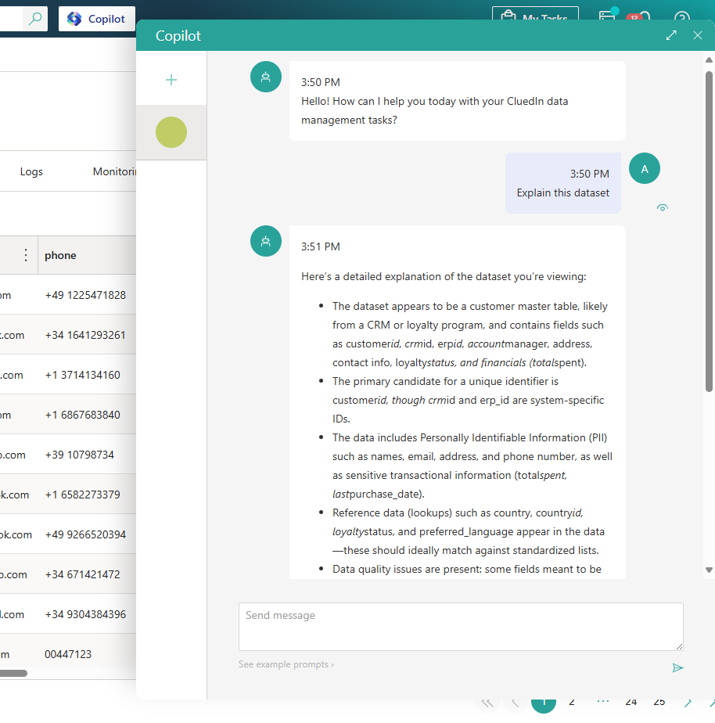


Learn more about CluedIn Copilot in our documentation portal.
Next session: Explore the CluedIn AI capabilities.

